Slide 1

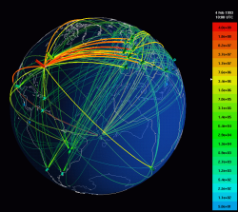
Internet Traffic Classification CSE881 Project
Ke Shen, Yang Yang and Yuanteng (Jeff) Pei
http://yangyan5cse881-01.appspot.com/
Computer Science and Engineering Department
Michigan State University
Thursday, September 10, 2015

Slide 2
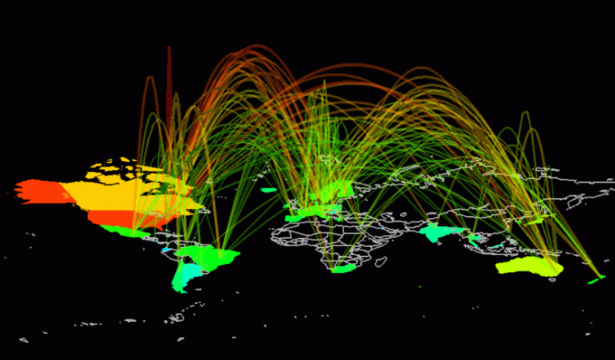
Outline
Overview
A Snapshot of What We Have Done
Data Set; DM Tasks and Motivation
Methodology
Preprocessing; Mining; Role of Members
Related Work
Experimental Setup
Knowledge Flow
Experimental Evaluation
Visualization Demo
Conclusions & Questions?

Slide 3

Overview - Project Snapshot
Implemented the solution to the Internet Traffic Classification problem in a SIGMETRICS'05 paper
Attempted to enhanced the solution by
Tuning the threshold for FCBF method for feature selection (in the paper, the threshold is not explicitly given)
Using Genetic-Algorithm for feature selection
Using Decision Tree method besides the original Naïve Bayes for classification in the paper
Achieved better than paper’s results for average accuracy:
Paper: 94.29% for FCBF+NB
Ours: 99.25% for FCBF+J48; 97.02% for FCBF+NB
Designed the knowledge flow diagram in Weka to implement the feature seletion, discretization, classification, performance visualization in a single step.

Slide 4
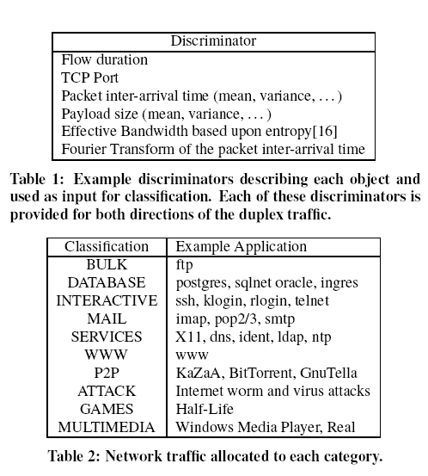
Overview Cont’d
Data Sets:
248 Features of a TCP traffic packets flow between two hosts.
Too many features! Need feature selection preprocessing.
A day trace was split into ten data sets of approximately 1680 seconds (28 min) each.
A TCP flow:(Source IP, Dest IP, Source Port, Dest Port, Protocol)
Data Mining Approaches:
Naïve Bayes (in the paper)
Decision Tree
Example discriminators describing each object and used as input for classification. (248 in total)
Network traffic allocated to each category. (10 in total)

Slide 5

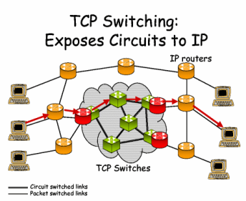
Overview Cont’d: Motivation
Many Internet applications poses high requirements on traffic classification:
Intrusion detections (security monitoring)
Trend analysis
Traffic controls
Quality of Service
Providing operators with useful forecasts for long-term provisioning

Slide 6
Outline
Overview
A Snapshot of What We Have Done
Data Set; DM Tasks and Motivation
Methodology
Preprocessing; Mining; Role of Members
Related Work
Experimental Setup
Knowledge Flow
Experimental Evaluation
Visualization Demo
Conclusions & Questions?

Slide 7




FCBF-based Feature Selection
FCBF: Fast Correlation-Based Filter
Relevance of Features:
Entropy:
Information gain:
Symmetrical uncertainty:
Main Idea:
Compute the correlation of each feature with the class
Use the threshold to filter the results: with top n features left
Further trim the set by filtering out those features which themselves’ correlation is greater than the correlation with the class
How to decide the threshold?
Wrapper method (Naïve Bayes)

Slide 8

GA-based Feature Selection
Each chromosome is a binary string of length 248.
1011100000111110100000…
Fitness Function:
Classification accuracy
Relevance of features
Number of features
Parameters
Population size: 80
Number of generations: 40
Probability of crossover: 0.6
Probability of mutation: 0.033
Classifier: Naïve Bayes

Slide 9
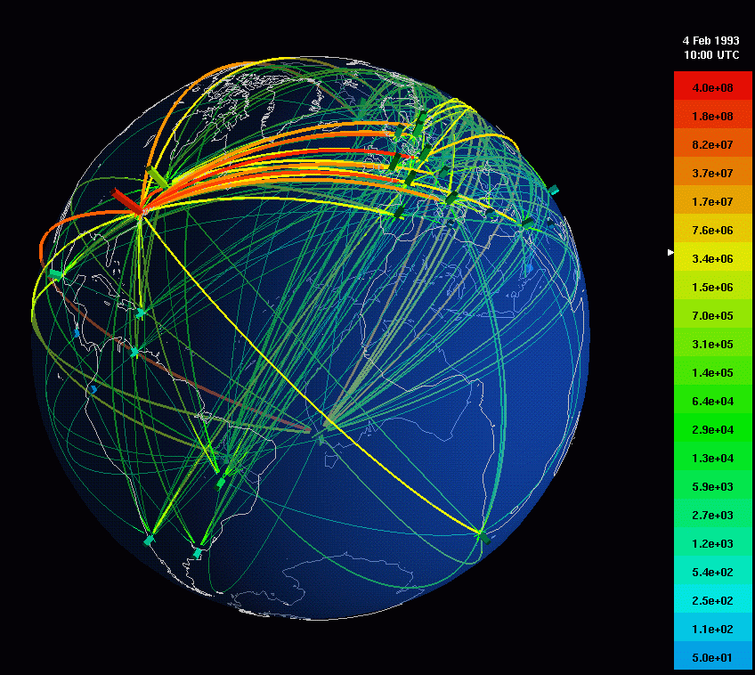
Methodology- Task Allocation
Shen, Ke
Preprocessing
Data Mining
Yang, Yang
Visualization
Pei, Yuanteng
Preprocessing
Data Mining

Slide 10
Related Work
Previous Work: Approaches for traffic classification
port-based analysis: classify the traffic flows based on known port numbers
payload-based analysis, e.g., whether they contained characteristic signatures of known applications
This project:
Supervised Behavioral Internet Traffic Classification: Classify the traffic flows based on their behaviors.
Discriminators/Features: Characteristics describe the flow behavior – flow duration, TCP port etc
Traffic-flows: a tuple of src/dst IP, protocol, src/dst port

Slide 11
Outline
Overview
A Snapshot of What We Have Done
Data Set; DM Tasks and Motivation
Methodology
Preprocessing; Mining; Role of Members
Related Work
Experimental Setup
Knowledge Flow
Experimental Evaluation
Visualization Demo
Conclusions & Questions?

Slide 12
Experimental Setup
Obtained the dataset from: http://www.cl.cam.ac.uk/research/srg/netos/nprobe/data/papers/sigmetrics/index.html
Use the 1st set for training, use 2nd -10th for test
Experiments were conducted on a 2.4 GHz Intel Quad Desktop running Windows Vista with 4GB RAM
Use Weka Knowledge Flow for feature selection classification (Weka 3.5)
Example discriminators describing each object and used as input for classification. (248 in total)
Network traffic allocated to each category. (10 in total)

Slide 13
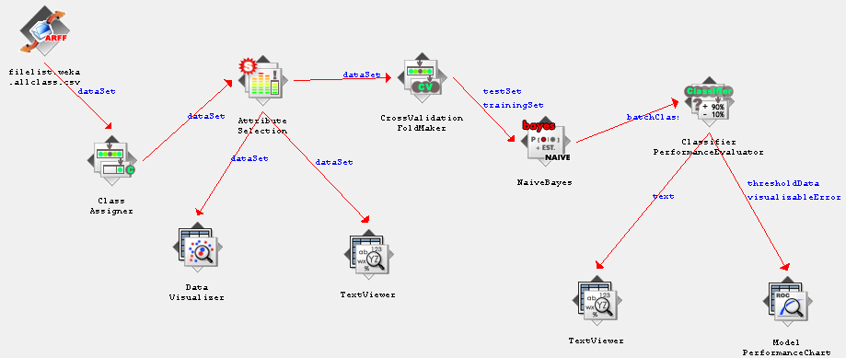
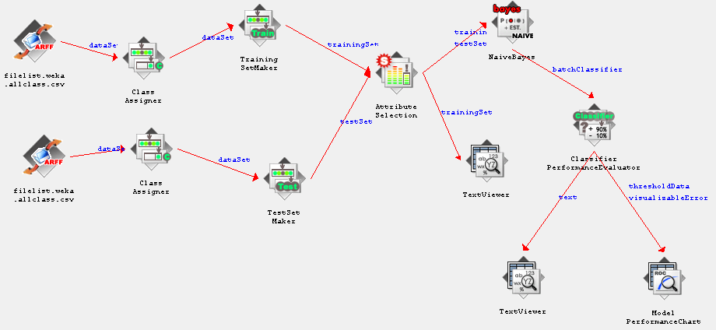
Experimental Setup - Cont’d Knowledge Flow
Right →:
KF to decide the optimum threshold in FCBF
Use Set1 with cross validation
← Left:
KF for Decision Tree/ Naïve Bayes Classification with GA/FCBF feature selection

Slide 14
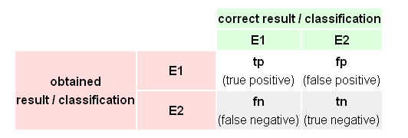
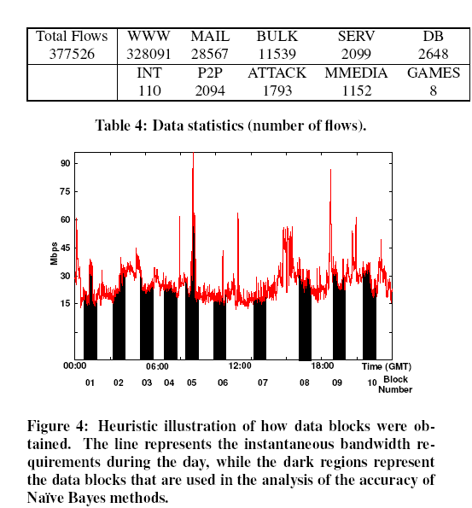
Experimental Evaluation
Metrics:
For the whole set:
Accuracy
# of flows classified correctly divided by the total # of flows
For each class:
Precision; Recall
Recall
Precision

Slide 15
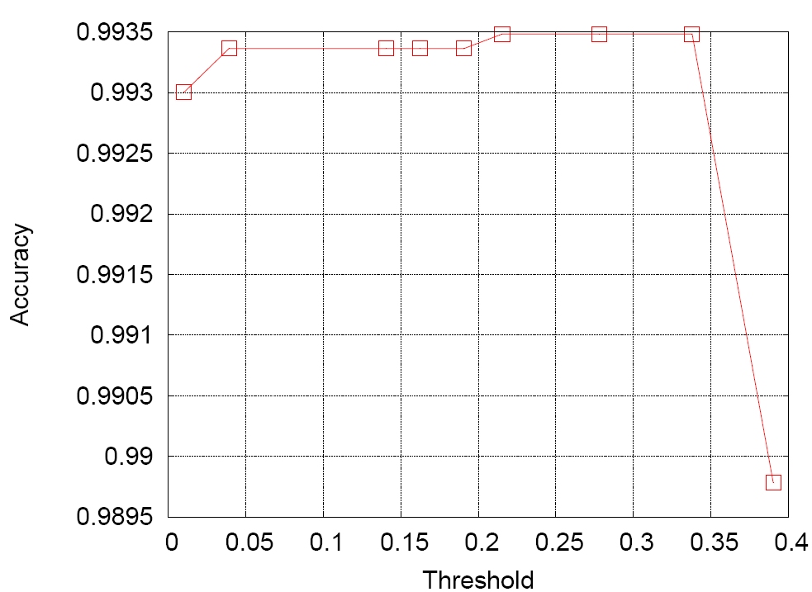
Experimental Evaluation Cont’d
Preprocessing
Threshold = 0.338; Accuracy = 99.35%
Only selected four features:
Server port
Pushed data packets from server to client
Initial window-bytes from server to client
Maximum Segment Size requested as a TCP option in the SYN packet opening the connection from client to server
Classification
Decision Tree (J48 in Weka) & Naïve Bayes
Use discretization would enhance the classification accuracy (for Naïve Bayes from 86% → 95%)
In Naïve Bayes of Weka setting: Use supervised discetization = true
Results will be showed in the visualization

Slide 16
Outline
Overview
A Snapshot of What We Have Done
Data Set; DM Tasks and Motivation
Methodology
Preprocessing; Mining; Role of Members
Related Work
Experimental Setup
Knowledge Flow
Experimental Evaluation
Visualization Demo
Conclusions & Questions?

Slide 17
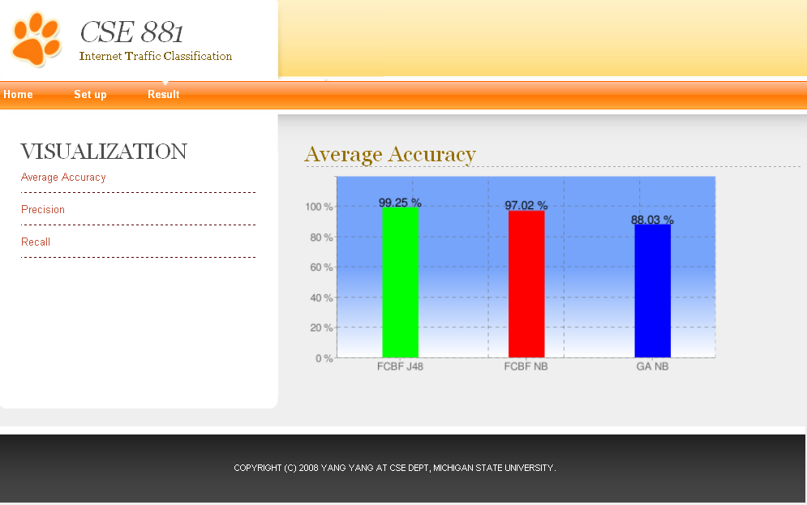
Visualization Demo
http://yangyan5cse881-01.appspot.com/

Slide 18
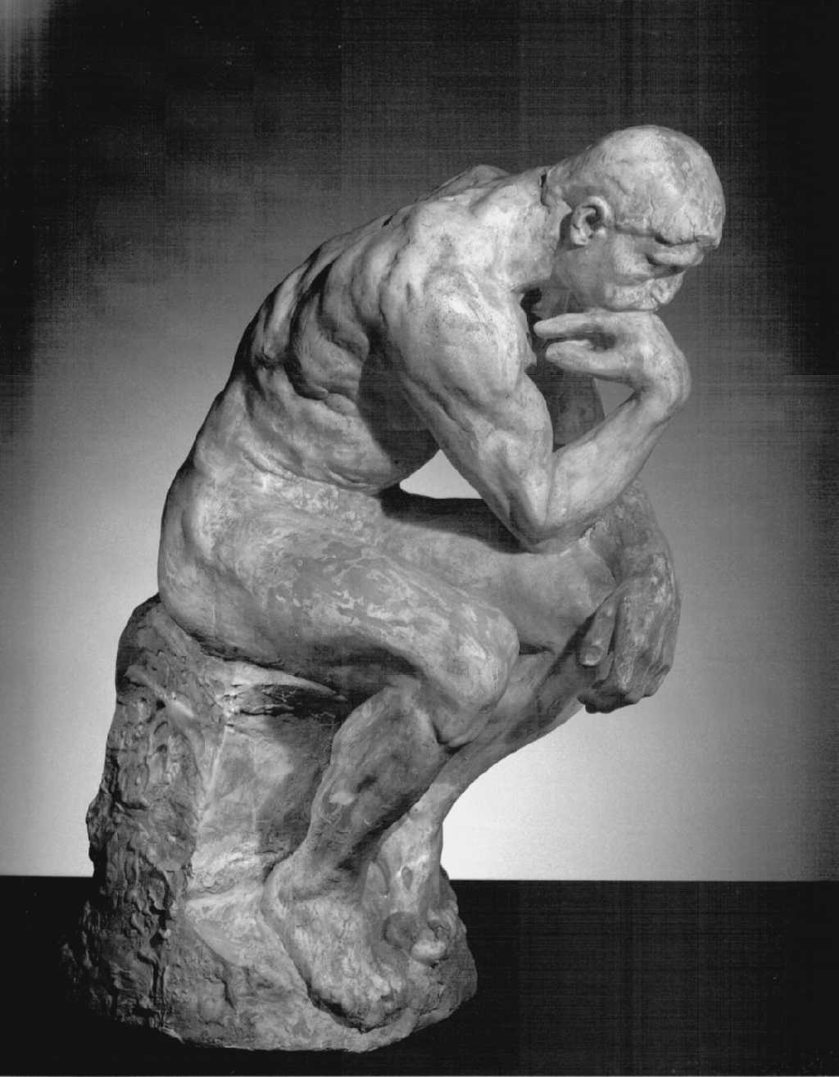
Conclusions & Questions? ☺
Insights:
Decision tree method interestingly performs very well in our experiment
99.25% for FCBF+J48;
97.02% for FCBF+NB
Knowledge flow is a powerful tool to streamline the design of the chained data mining task
Attribution Selection: Quality rather than Quantity
Future Work:
Use multi data sets as training set
Attempt SVM to validate its performance
Thanks Dr. Tan for kind guidance and valuable advice.

